Slide 1
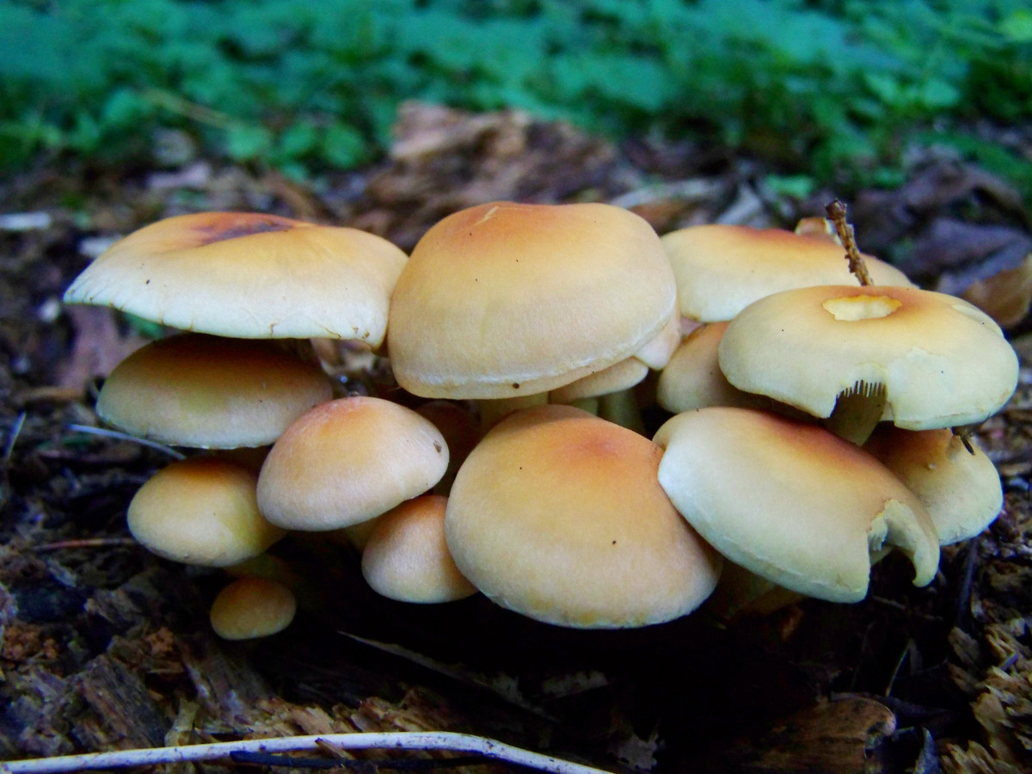
MUSHROOM ANALYSIS PRESENTATION
By Anima Sharma

Slide 2
PROJECT OBJECTIVE
Classify mushrooms as edible or poisonous using data-driven analysis and predictive modeling to ensure safety and informed decision-making

Slide 3
Data Overview
Dataset Summary:
Source: Mushroom dataset
Number of Records: 61069
Number of Features: 21 features
Target Variable: mushroom_class – Edible (e) or Poisonous (p)
Feature Types:
Categorical Features: 18
Numerical Features: 3
Target Feature: 1

Slide 4
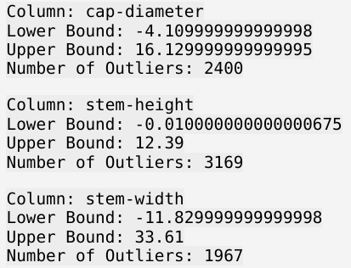
Data Overview
Missing Values
There are missing values present in columns: cap-surface, gill-attachment, gill-spacing, stem-root, stem-surface, veil-type, veil-color, ring-type and spore-print-color.
Outliers

Slide 5
Feature Explanation
Column Name | Description | Values
mushroom_class | Classification of mushrooms | Poisonous(‘p’) or edible(‘e’)
cap_diameter | Diameter of the mushroom cap | Numerical
cap_shape | Shape of the mushroom cap | bell=b, conical=c, convex=x, flat=f, sunken=s, spherical=p, others=o
cap_surface | The surface texture of the mushroom cap | fibrous=i, grooves=g, scaly=y, smooth=s, shiny=h, leathery=l, silky=k, sticky=t, wrinkled=w, fleshy=e
cap_color | The color of the mushroom cap | brown=n, buff=b, gray=g, green=r, pink=p,purple=u, red=e, white=w, yellow=y, blue=l, orange=o, black=k

Slide 6
Feature Explaination
Column Name | Description | Values
does_bruise_or_bleed | Whether the mushroom bruises or bleeds | bruises-or-bleeding=t,no=f
gill_attachment | Attachment type of the gills | adnate=a, adnexed=x, decurrent=d, free=e, 9. sinuate=s, pores=p, none=f, unknown=?
gill_spacing | Spacing between gills | close=c, distant=d, none=f
gill_color | Color of the gills | see cap-color + none=f
veil-type | Type of veil covering the gills | partial=p, universal=u
stem_height | Height of the mushroom stem | Numerical (cm)
stem_width | Width of the mushroom stem | Numerical (mm)
stem_color | Color of the mushroom stem | see cap-color + none=f

Slide 7
Feature Explanation
Column Name | Description | Values
stem_root | Root type of the mushroom stem | bulbous=b, swollen=s, club=c, cup=u, equal=e, rhizomorphs=z, rooted=r
stem_surface | Surface texture of the mushroom stem | see cap-surface + none=f
has_ring | Whether the mushroom has a ring | ring=t, none=f
ring_type | Type of ring on the mushroom | cobwebby=c, evanescent=e, flaring=r, grooved=g, large=l, pendant=p, sheathing=s, zone=z, scaly=y, movable=m, none=f, unknown=?

Slide 8
Feature Explanation
habitat | Habitat where the mushroom is found | grasses=g, leaves=l, meadows=m, paths=p, heaths=h, urban=u, waste=w, woods=d
season | Season in which the mushroom is found | Sring=s, summer=u, autumn=a, winter=w
veil-color | Color of the veil | see cap-color + none=f
spore-print-color | Color of the spore print | see cap color

Slide 9
Data Cleaning and Preprocessing
Data Quality Assessment
Verified dataset structure with 61069 records and 21 columns
Checked for missing, inconsistent, and invalid values across all features
Missing Values
Missing values observed in the dataset were treated
Columns ring_type, cap_surface, and gill_attachment were filled using mode due to low to moderate missing values.
Columns gill_spacing, stem_surface, and stem_root were filled with 'Unknown' because of high missing-value proportions.
Columns veil_type, veil_color, and spore_print_color were dropped due to extremely high missing values.

Slide 10
Data Cleaning and Preprocessing
Duplicates
146 duplicate rows were detected. Duplicate rows were not removed, as repetition is expected due to the categorical nature of the dataset.
Categorical Data Handling
Most features are categorical in nature
Applied encoding techniques to convert categorical variables into numerical format suitable for machine learning models
Label encoding was applied to the target variable mushroom_class (e → 0, p → 1).
One-hot encoding was used for feature variables.

Slide 11
Data Cleaning and Preprocessing
Outliers Treatment
Outliers in numerical columns were handled using the capping method to reduce skewness without data loss.
Column Name Enhancing
Column names were standardized by replacing hyphens (-) with underscores (_).
The target column 'class' was renamed to 'mushroom_class.

Slide 12
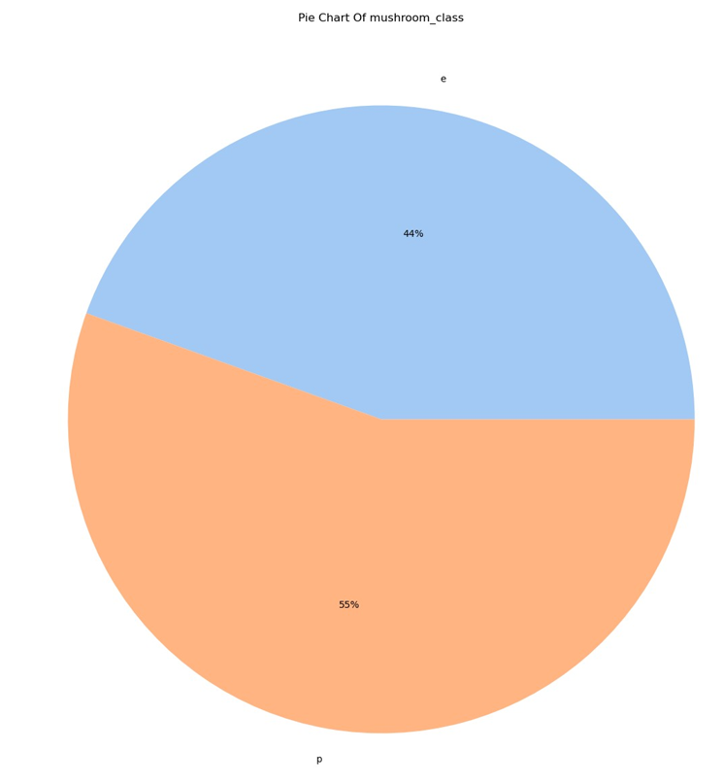
Exploratory Data Analysis
EDA Insights
The target variable shows a balanced distribution, enabling unbiased analysis and model training.

Slide 13
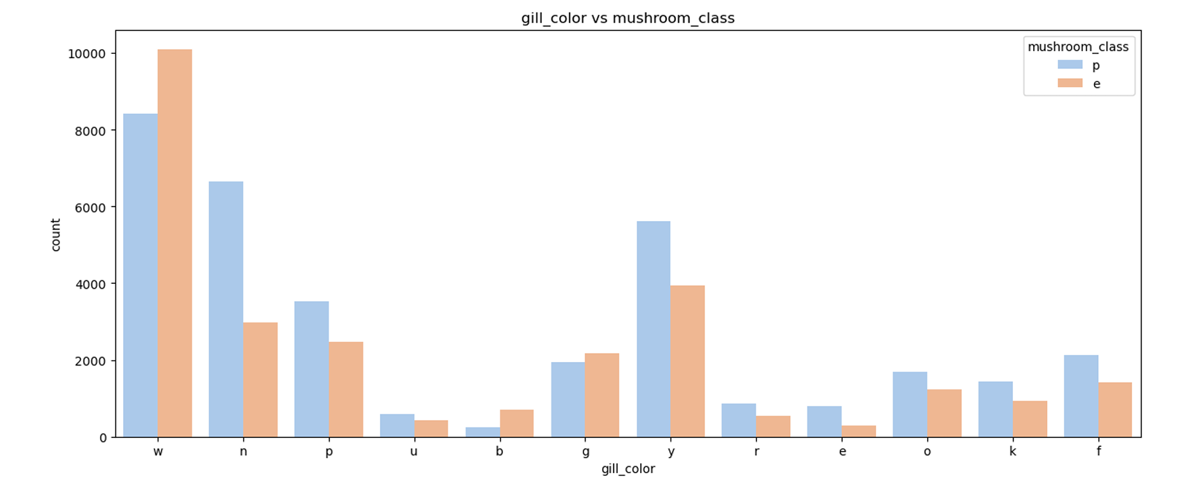
Exploratory Data Analysis
Gill color shows a strong relationship with mushroom class, with certain gill colors predominantly associated with poisonous mushrooms.

Slide 14
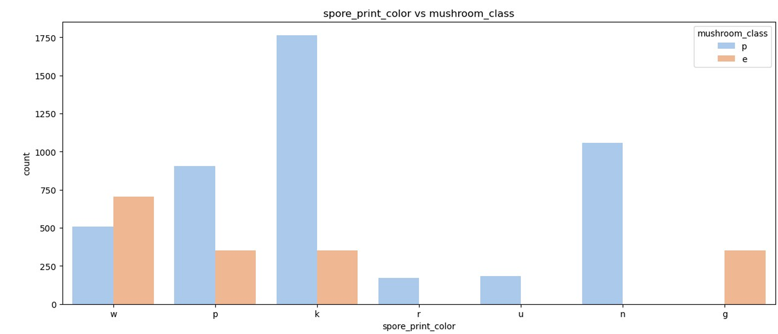
Exploratory Data Analysis
Spore print color exhibits a clear dependency on the target variable, indicating high discriminatory power between edible and poisonous classes.

Slide 15
Exploratory Data Analysis
Stalk-related features (such as stalk surface and stalk shape) contribute significantly to classification by reinforcing patterns observed in other features.
Cap-related features (cap color and cap shape) show moderate influence and improve prediction accuracy when combined with stronger predictors.
Habitat provides contextual support, helping refine predictions, though it is not a decisive feature on its own.
FINAL INSIGHT –
EDA revealed that gill color, spore print color, and stalk characteristics exhibit the strongest relationships with mushroom edibility, making them key drivers for model performance.

Slide 16
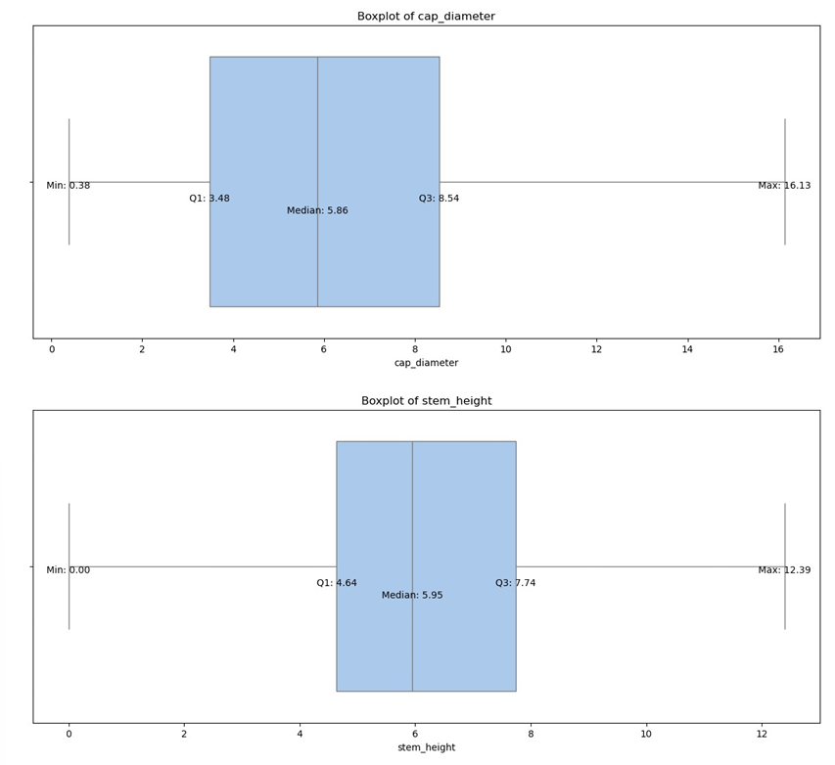
Exploratory Data Analysis
Boxplot Visuals

Slide 17
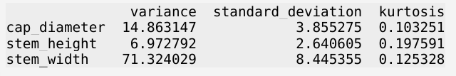
Statistical Analysis
Skewness
Since the dataset is fully categorical, skewness is observed in terms of category dominance rather than positive or negative numerical skewness.
Statistical Measures

Slide 18
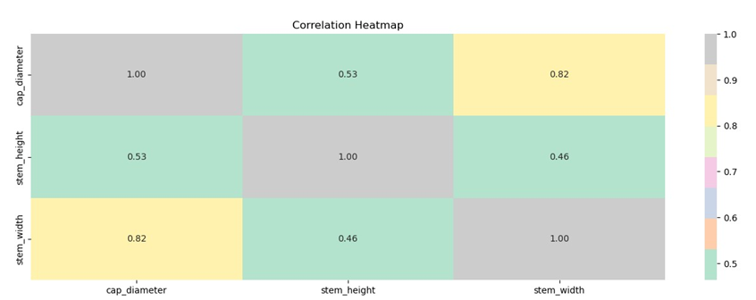
Correlation Analysis

Slide 19
Correlation Analysis
No strong positives were observed.
A good positive relation is observed between cap diameter and stem width.
No strong negatives were observed.
Due to absence of strong positives and negatives, multicollinearity was not seen between numerical features.

Slide 20
Machine Learning Objective
The objective of machine learning is
To Develop a predictive model to classify mushrooms as edible or poisonous.
To Evaluate multiple classification models to identify the best-performing approach.
Problem Framing
Type of problem: Binary Classification
Input: Mushroom features
Output: Mushroom class (Edible/Poisonous)
Approach: Supervised learning

Slide 21
Data Preparation for Modeling
Cleaned the data by treating missing values.
Encoded categorial variables into numerical format.
Final dataset was then prepared fir machine learning compatibility.

Slide 22
Train–Test Strategy
Dataset split into training and testing sets.
Data was split in the ratio of 80 to 20.
80% of data was taken for training.
Remaining 20% was taken for testing.
Maintained class distribution across splits.

Slide 23
Models Implemented
The models which were implemented were as follows
Decision Tree
Random Forest
XG Boost
Ada Boost
Logistic Regression
These models were selected were selected because of their high performance and the fact that they are suitable for categorial feature based classification.

Slide 24
Model Evaluation Metrics
Measures taken for model evaluation were as follows
Accuracy
Precision
Recall
F1 score
Confusion Matrix
These all are used because it is a classification problem.
Recall is especially important to minimize false negatives for poisonous mushrooms.

Slide 25
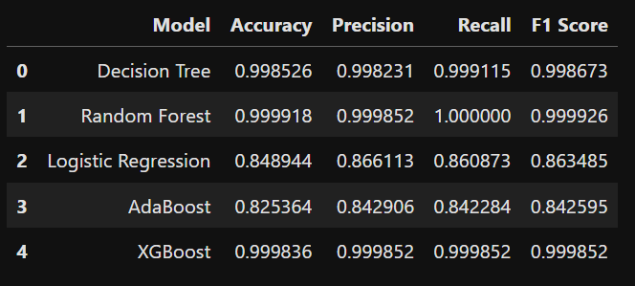
Model Performance Comparison
Compared model performance using evaluation metrics.
Tree-based models outperformed linear models

Slide 26
Best Model Selection
Best model’s performance was selected on basis of
Accuracy
Recall
F1-score
Result
Tree-based model chosen due to superior performance and robustness.
Random Forest was observed as the best model according to this dataset.

Slide 27
Model Results
High accuracy achieved on test data.
Strong recall ensures safe identification of poisonous mushrooms.
Model demonstrates high reliability and consistency.

Slide 28
Impact
Enables rapid and accurate mushroom classification.
Reduces risk of human error in manual identification.
Potential application in food safety and decision-support systems.

Slide 29
Conclusion
EDA revealed that gill color exhibit strong relationship with target variable.
Spore print color, and stalk characteristics exhibit the strongest relationships with mushroom edibility, making them key drivers for model performance.
Target variable is evenly spread and not biased.
Machine learning successfully classified mushrooms as edible or poisonous.
Strong alignment between EDA and model behavior.
Demonstrates practical applicability of data-driven decision making.
Approach can be used in food safety and risk prevention systems.

Slide 30
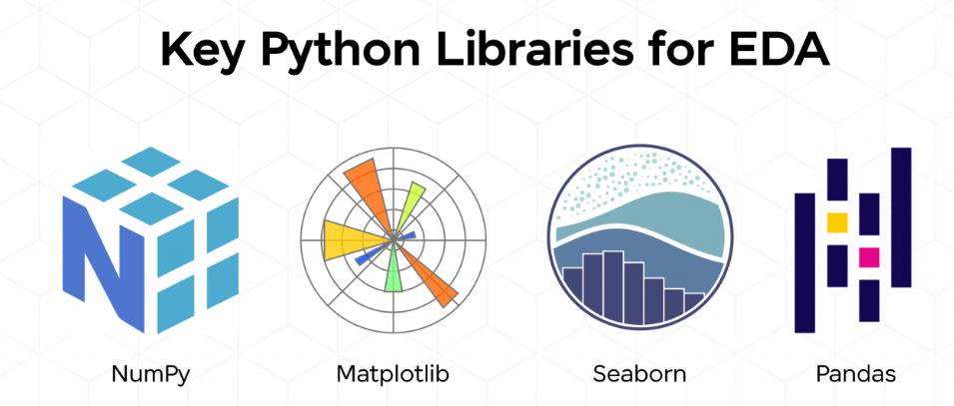
Tools Used

Slide 31
Summary
Thank you all for your attention
Feel free to ask questions
Presented by: Anima Sharma
Profession: Data Analyst
Email Contact: sharmaanima298@gmail.com
LinkedIn: http://linkedin.com/in/anima-sharma-46a621399

